Slide 1

Mastering Decision Trees in Python
Presenting By,
ASTHA(2023PGDM1045)
PRIYANSH VERMA(2023PGDM1194)
UTKARSH RAJ(2023PGDM1295)
NEERAJ SINGH CHANDEL(2023PGDM1390)
ANKIT KUMAR(2023PGDM1389)

Slide 2
What is a Decision Tree?
Tree-like Structure
Decision Making
A decision tree is a flowchart-like structure. Each internal node represents a test on an attribute. Each branch represents an outcome of the test. Each leaf node represents a class label.
It maps observations about an item to conclusions. These conclusions are the item's target value. It's used for both classification and regression tasks.

Slide 3

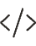



Key Python Libraries
Scikit-learn
Primary library for DecisionTreeClassifier and DecisionTreeRegressor.
Pandas
For efficient data loading and manipulation. Use pd.read_csv and DataFrame operations.
NumPy
Essential for numerical operations, underpinning data structures.
Matplotlib/Graphviz
For powerful tree visualization via export_graphviz function.

Slide 4





Implementation Steps in Python
Data Preparation
Load datasets like Iris or Titanic using Pandas for efficient handling.
Splitting Data
Divide your dataset into training (70-80%) and testing (20-30%) sets.
Model Training
Initialize DecisionTreeClassifier() and call model.fit(X_train, y_train).
Prediction & Evaluation
Use model.predict(X_test) and evaluate with accuracy_score (e.g., 92% accuracy on Iris).

Slide 5
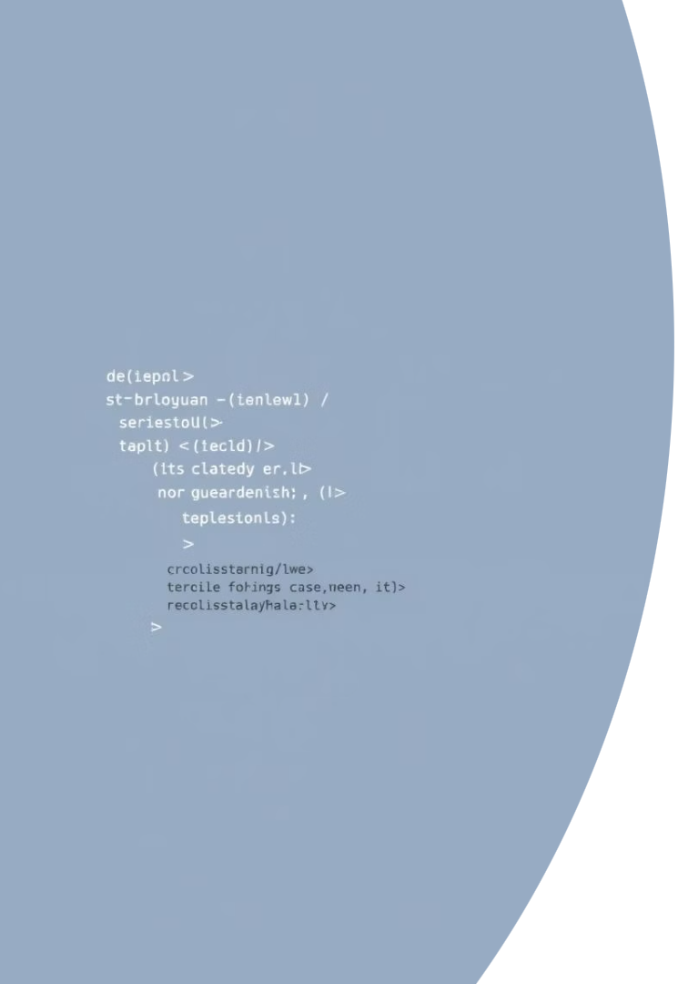
Decision Tree Syntax
from sklearn.tree import DecisionTreeClassifier
from sklearn.model_selection import
train_test_split
from sklearn.metrics import accuracy score
# Load data
X, y = load_iris(return_X_y=True)
# Split data
X_train, X_test, y_train, y_test =
train_test_split(X, y, test_size=0.3,
random_state=42)
# Create classifier object
dt_classifier = DecisionTreeClassifier()
# Train model
dt_classifier.fit(X_train, y_train)
# Make predictions
y_pred = dt_classifier.predict(X_test)
# Evaluate accuracy
accuracy = accuracy_score(y_test, y_pred)print(f"Accuracy: {accuracy:.2f}")

Slide 6

Visualization and Feature Importance
Tree Visualization
Feature Importance
Explainable AI
Use export_graphviz to visually map decision paths. This helps understand how specific conditions lead to classifications.
dt_classifier.feature_importances_ gives numerical insight. For Iris, petal length can show 0.99 importance.
Visuals and importance scores simplify model explanations. This helps non-technical stakeholders grasp complex predictions.

Slide 7

Future Scope of Decision Trees
Real-time Applications
Integration with Ensemble Methods
Adapt for faster processing and deployment. Use in fraud detection and dynamic recommendation systems.
Enhanced Interpretability
Develop more intuitive visualization tools. Improve methods for explaining complex decision paths.
Further optimize Random Forests and Gradient Boosting. Boost performance and robustness in diverse applications.

Slide 8
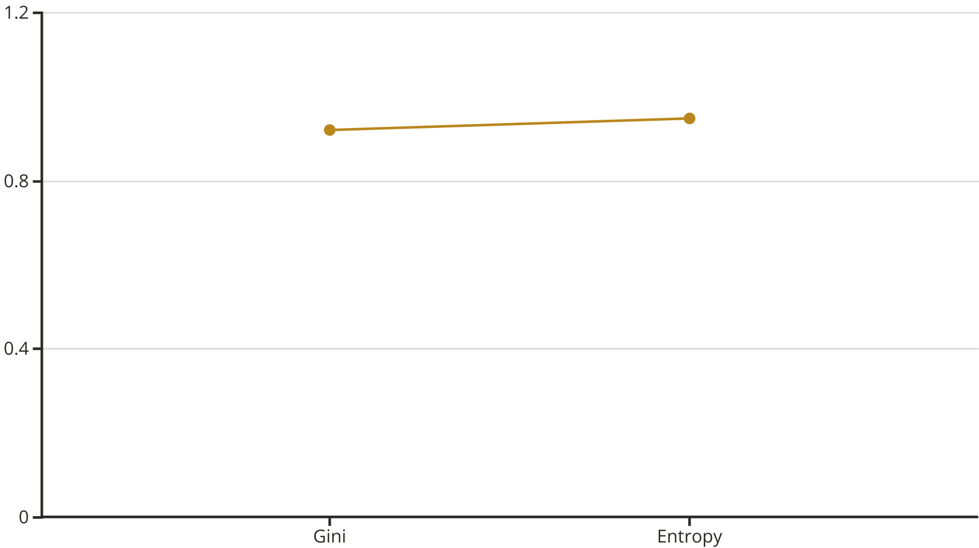
Decision Tree Example
Using the Iris dataset, a decision tree with the entropy criterion achieved higher accuracy. This shows how choosing the right criterion impacts model performance. The Gini impurity criterion also performed well, indicating the tree's robustness.

Slide 9

Conclusion & Next Steps
Decision trees are powerful and interpretable. They offer clear pathways for classification and regression. Python libraries like Scikit-learn make implementation straightforward.

Slide 10


